Slide 1
Lean Management Philosophy, tools and techniques, Kaizen, value stream mapping, lean services.
BUSI 104 – Operations Management
Professor Ed Arnheiter

Slide 2
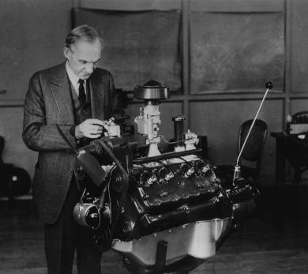
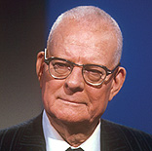
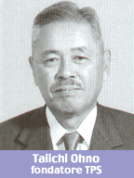
Lean Pioneers
W. Edwards Deming
Taiichi Ohno
Henry Ford
Creator of the Toyota Production System (TPS)
Lean can be defined as a business system that seeks to maximize value to customers, both internal and external, while simultaneously removing wasteful activities and practices.

Slide 3
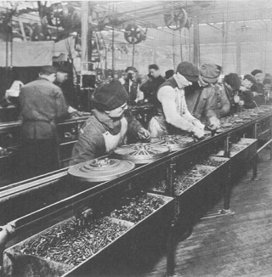
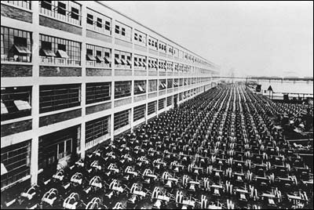
The Original “Lean Thinker”
Henry Ford & the automobile industry
Moving assembly line
Model T reduced in price from $850 to $290
Ford (in 1926) claimed that the “lead time from the mining of iron ore to the production of an automobile was 81 hours.”

Slide 4
Human Aspects of Lean
Fear-free environment
Respect for People!
Blameless culture
Training
Discipline
Bottom-round management

Slide 5
A Recurrent Theme of Lean Management
Continuously strive to:
Minimize all forms of waste in the value-stream.
Eliminate non value-added activities.
Notes:
Ended here on 3/24/16

Slide 6
Applying Lean in Manufacturing
Specify value - from each customer’s perspective
Map value stream – understand all activities that take place while manufacturing the product
Optimize flow - minimize interruptions that could take place during production
Create pull – work should be initiated by customer demand
Strive for perfection – goal is zero waste

Slide 7
Applying Lean in Services
Specify value - from each customer’s perspective, considering all "dimensions" of quality
Map service process – understand all activities that take place while providing service
Identify value-added activities and waste - focus on main areas of waste supplemented with data
Work to eliminate waste and add value – attempt to simplify rather than complicate
Continuously evaluate the service – goal is maximal value with minimal waste

Slide 8
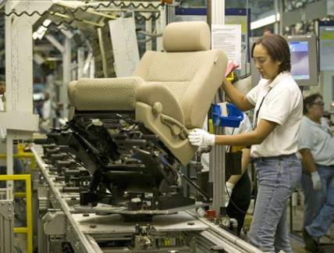
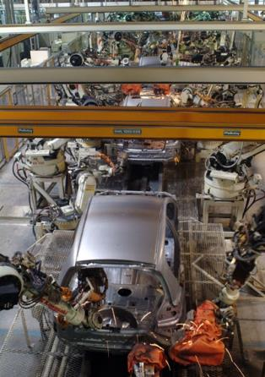
More Key Lean Traits
Robots for Dangerous or Unpleasant Tasks
Strong Supplier Relationships

Slide 9
Value Added vs. Non-value Added
Value Added (VA)
Activities which change form, fit, or function of product/service AND
Activities which customer cares about/is willing to pay for AND
Activities done right the first time
Non-Value Added
Activities that consume resources but create no value in the eyes of the customer
Necessary Non-Value Added (NNVA)
Activities which may be necessary for business or other reasons but do not add value in the eyes of the customer
May include activities required for the process to function, regulatory, compliance, legal, etc.
Waste
Pure waste (8 forms of waste)

Slide 10

The Eight Wastes
VA Activity - Something Changes, Done Right, Customer Cares
Required Non-Value-Add (NVA) Activity
DEFECTS
OVER PRODUCTION
WAITING
NOT USING PEOPLE Well
TRANSPORTATION
Waste
INVENTORY
MOTION
EXCESS PROCESSING
Remember: DOWNTIME

Slide 11
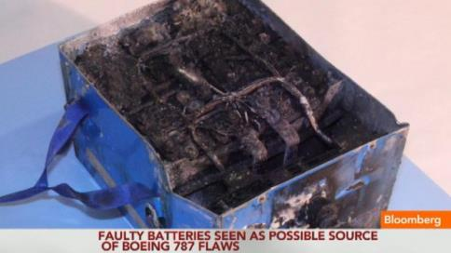
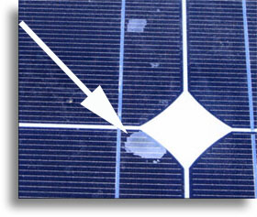
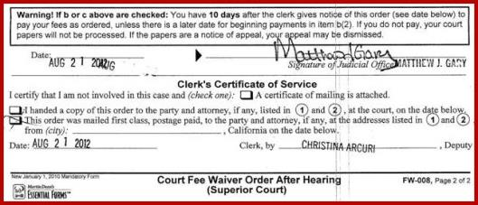
Defects (Toyota calls “Rework”)
Errors, mistakes, rework – can be very costly

Slide 12
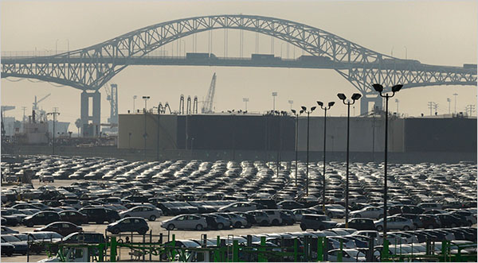
Overproduction (Toyota calls Over Processing)
Producing more than required, earlier than required or faster than required

Slide 13


Waiting
Employees and customers waiting for resources to perform their work

Slide 14


Not Using People Well

Slide 15
Transportation (Toyota calls this Conveyance)
Excessive product or data movement
Diagram of backhoe travel

Slide 16
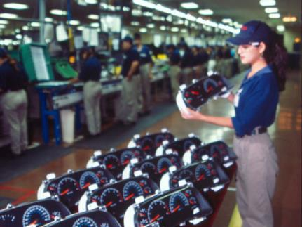
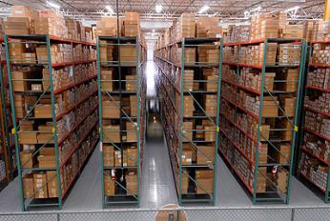
Inventory
Holding more inventory (materials and information) than required
Inventories add clutter and take up space.
Usually symptom of unreliable supply chain.
WIP is direct result of overproduction and waiting

Slide 17
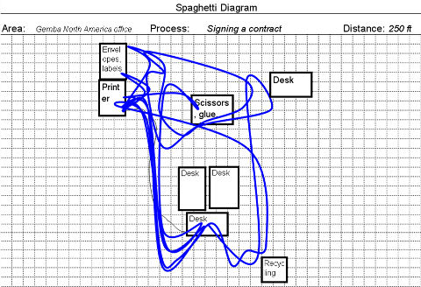
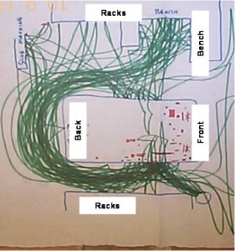
Motion
Excessive motion of people

Slide 18

Excess Processing (Toyota calls Over Processing)
Doing more work than is really necessary
Using expensive equipment when simpler machines would suffice

Slide 19

Flow
Use continuous flow wherever possible
Use small batches or single-piece flow
Assembling Model T clutch plates

Slide 20
Single-Piece Flow in Services
Some services (with fairly constant processing times) can achieve single "customer" flow
example: an Optometrist office
Many services (with highly variable processing times) should not consider single "customer" flow
example: IT troubleshooting

Slide 21
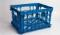
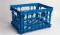
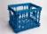
Pull
Use where continuous flow is interrupted and upstream process still operates in batch mode
Upstream Department
(Batch Mode)
Supermarket
D
C
E
B
Continuous Flow
F
A
Schedules forging process
In
Out
Don’t make anything until needed by downstream customer.

Slide 22
Visual Workplace
Anyone should know the who, what, when, where, why and how of a work area within five minutes
…without having to ask anyone
…without having to search
…without having to analyze
…without having to interpret
…without having to…..
Source: Productivity, Inc.

Slide 23
Visual Workplace
Situation
What are our goals and targets? How are we doing in meeting them?
Are conditions abnormal, or hazardous?
How is the operation proceeding?
Location
Where can I find _____?
Where does this item go?
What goes here?
What caution/restrictions apply in this area?
Action
What needs to be done?
Am I doing this properly?
Where does this go next?
What is the next item to be worked on?
People
Who does what around here?
Who can help me?

Slide 24
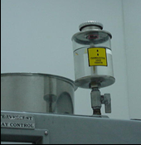
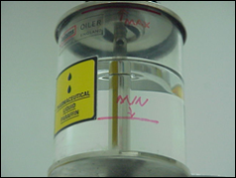
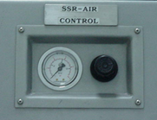
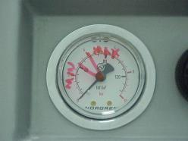
Situation – How do we Know?
Before
After
Before
After

Slide 25
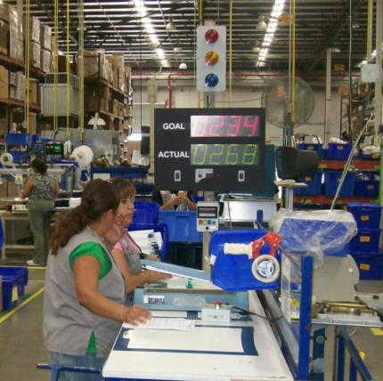
Situation – How do we Know?
Top: number expected at this time if we are to meet target.
Bottom: actual production completed at this time.
In some Lean systems, an "andon" is visual mechanism to signal that work will not be completed within takt time allocation.

Slide 26
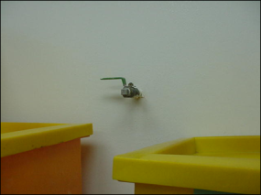
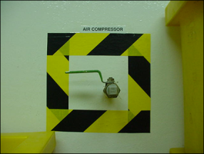
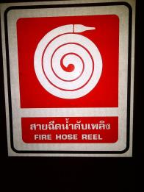
Location – Where can I Find ____?

Slide 27
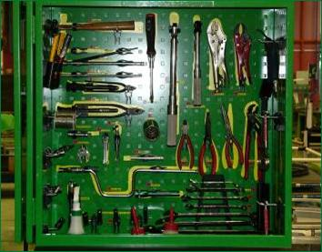
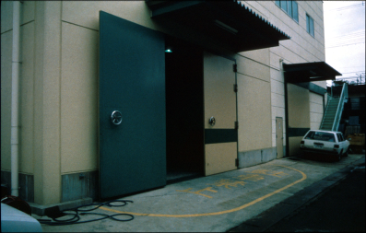
Location – Where can I Find ____?

Slide 28
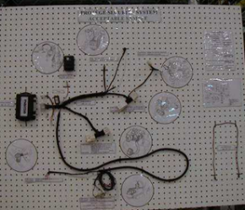
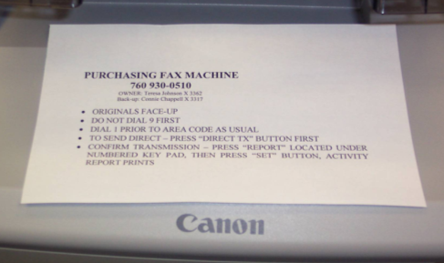
Action – What needs to be done?
Sample product, and graphical work aids for how each terminal should look

Slide 29
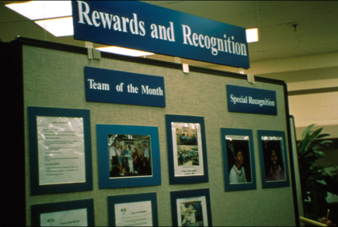
People – Who does what?

Slide 30
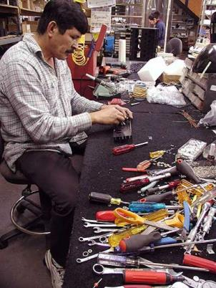
The 5S’s Support the Visual Workplace
“Sort”
Sort through, then sort out
Identify what you need, and discard what is unnecessary.
“Straighten”
Organize what remains.
Assign separate location for essential items.
Make space self-explanatory (obvious where items belong)

Slide 31
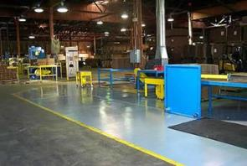
The 5S’s (Continued)
“Shine”
Clean equipment, tools, and workplace.
Keep workplace spotless at all times.
“Standardize”
Schedule cleaning & regular maintenance for equipment and tools.
“Sustain”
Stick to rules - make them way of life.

Slide 32
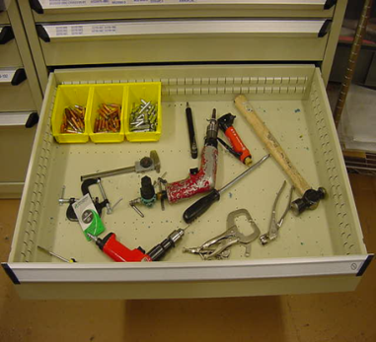
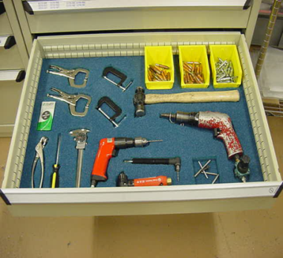
5S Example
Before
After
Which 5S Element is obvious from the RH Photo?

Slide 33
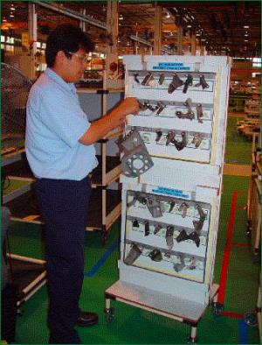
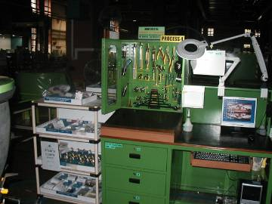
5S Examples

Slide 34
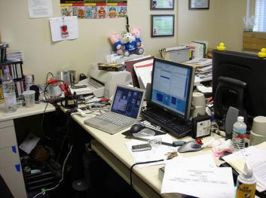

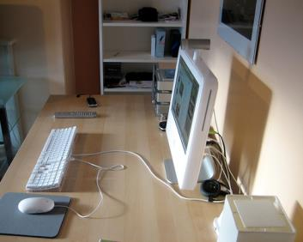
Work Areas Needing 5S Audit!
Versus

Slide 35
Mistake Proofing (Poka-Yoke)
Descending degree of difficulty:
Develop processes that cannot make defects
Develop sensing within process to shut down when defect has been made
If defect made, system does not allow part to go to next operation.

Slide 36
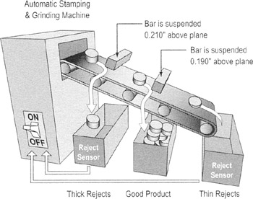
Is it a Mistake Proofing Device?
Does it prevent the mistake or detect the defect?
Is it 100% reliable?
Is it easy to implement and to use?
Is it durable and easy to maintain?
Is it low cost?
Self-checking of product thickness

Slide 37
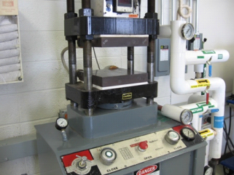
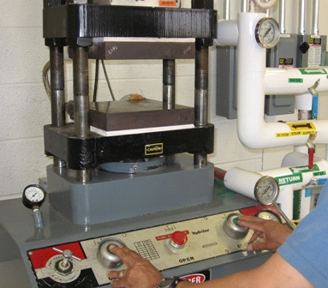
Mistake Proofing Example
Press both buttons simultaneously to activate machine

Slide 38

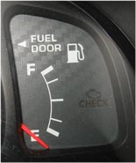
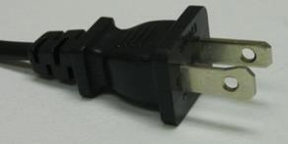
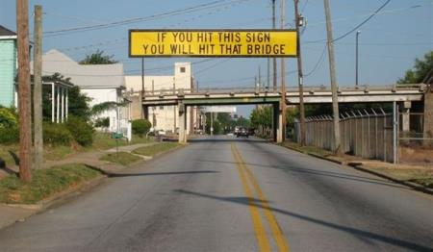
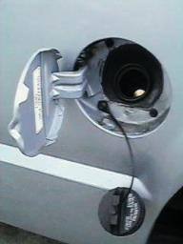
Everyday Examples

Slide 39
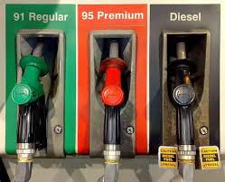
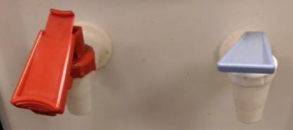
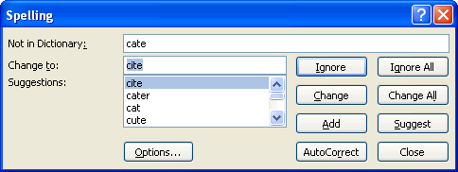
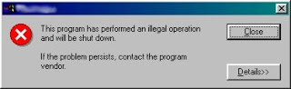
Everyday Examples

Slide 40

Takt Time
Takt time is calculated value that sets pace of production to match rate of customer demand.
Ideally, we make 100/minute only if customer demand is 100/minute

Slide 41
Takt Time Calculation
Forecast demand rate
Set throughput equal to demand rate
Calculate takt time (example follows

Slide 42
Example Takt Time Calculation
Available work time per shift
Customer demand rate per shift
Shift time = 8 hours = 28,800 seconds
Breaks = 20 minutes = -1200 seconds
Total daily operating time = 27,600 seconds
Total daily required quantity = 690 pieces per shift
Takt Time = 27,600/690 = 40 seconds

Slide 43
Takt Time in Services
Some services operate like manufacturing processes relative to their near-constant processing times:
Bill processing, routine personal services
But in most cases, takt time cannot be applied to services since service times often vary significantly from customer to customer:
Help lines, proposal development, repair, engineering design, negotiations, etc.

Slide 44


Related Technique: Andon
In some Lean systems, an "andon" is visual mechanism to signal that work will not be completed within takt time allocation.
Examples: defect, shortage, machine malfunction, incomplete information to proceed.
Example signals: cord, light, andon boards or post-it note.
Notes:
The andon board communicates abnormalities along the assembly line.
Ended here on 3/31/16

Slide 45
Value Stream Mapping
A Special Type of Process Flow Diagram

Slide 46

The Value Stream Map (VSM)
One-page, data rich, picture of macro level processes in an organization.
Tool used to analyze the non valued-added time of the entire process.
Tool used for identification of opportunities for improvement
Current state value stream maps identify the improvement opportunities
Future state value stream maps demonstrate the “should be” future state

Slide 47
The Value Stream Perspective
“Local” optimization
Customer to End User
Suppliers
Your Plant or Company
Total Value Stream
“Global” optimization

Slide 48

VSM Uses Set of Special Icons
Different from Traditional PF Diagrams

Slide 49

VSM Uses Set of Special Icons
Different from Traditional PF Diagrams

Slide 50
Acme Stamping Current State Timeline Added
State St
Assembly
90/60/30
forecasts
6wk
forecast
Michigan
Steel
Prod Cont
18,400 pc/mo
-12,000 “L”
-6,400 “R”
Daily order
Weekly
fax
MRP
500 ft coils
Tray = 20 pc
2 Shifts
Weekly Schedule
Tue & Thu
Daily Ship
Schedule
1x
daily
Stamping
Weld #1
Weld #2
Assy #1
Assy #2
Shipping
I
200 Ton
I
I
I
I
I
Staging
Coils
5 d
1
7,000
1
1,700
1
2,450
1
1,840
1
4,140
CT = 1 s
CT = 39 s
CT = 46 s
CT = 62 s
CT = 40 s
30 s
CO = 1h
CO=10 m
CO=10 m
CO = 0
CO = 0
U/T = 85%
U/T= 100%
U/T= 100%
U/T = 100%
U/T = 100%
27,600 s avail.
2 Shifts
2 Shifts
2 Shifts
2 Shifts
27,600 s avail.
27,600 s avail.
27,600 s avail.
27,600 s avail.
30.4 days
5 d
9.89 d
2.83 d
5.50 d
2.67 d
4.5 d
1 s
39 s
46 s
62 s
40 s
218 sec

Slide 51
Productive Ratio Calculations
Productive Ratio = (218/838,900)(100)% = 0.026%

Slide 52
Example VSM Timeline Calculations
I
I
I
I
Step 1
40
Step 2
5
Step 3
20
Step 4
45
Step 5
1
1
1
1
1
CT = 9.04 s
CT = 12.35 s
CT = 14.8 s
CT = 8.5 s
2025 s
9.04 s
12.35 s
14.8 s
8.5 s
45 s
FPY = 97.2%
FPY = 96.8%
FPY = 96.3%
FPY = 98.3%
FPY = 100%
Productive ratio =
Rolled Throughput yield (RTY) =
% Correct & Accurate (%CA) as seen by the customer

Slide 53

Acme Stamping: Completed Future State

Slide 54

Current State Map for Blood Bank

Slide 55

Current State – Healthcare Example

